Slide 1
Senior Service America, Inc. (SSAI)
PY2018 Recertification Webinar
Presenters, Program Officers:
Constance Todd
Don Gatewood
Janet Ray

Slide 2
We will start in 5 minutes.
To connect your phone to the webinar, please dial-in by following the instructions (to see those instructions again select Dial-In Instructions from the Audio/Video Menu)

Slide 3
To best view the presentation, Click the Whiteboard (or full Screen) Icon:
During the presentation you may also use the scrolling bars to view content that is hidden

Slide 4
Telephones will be muted during the presentation
We will have Question and Answer segments throughout the presentation, and at the conclusion of the presentation.
To ask a question during the Q&A, select click on the Chat icon in the bottom bar and send us a note either with your question or indicating you have a question. We will open the phone lines with you.

Slide 5
SCSEP Recertification Webinar
PY 2018
January 31, 2019

Slide 6

Remember to focus on your goals during recertification
Meet 100% Service Level Goal
Meet 100% of your MIN Goal
Complete all your follow-ups for Q2 and Q4 employment rates and Median Earnings
Spend 100% of PWFB

Slide 7

Today’s
Presenters
Program Officers:
Constance Todd
Don Gatewood
Janet Ray

Slide 8

Today’s Agenda
Getting Ready and Planning
Documentation Requirements
Eligibility Determination
SPARQ & New Database
Questions and Answers

Slide 9
SSAI Recertification for PY2018
Annual recertification of SCSEP eligibility is a federal requirement
All SSAI participants will be recertified during March 2019, including any participants who were enrolled in February 2019
You do not have to recertify participants who have Open or Active Workers Comp claims
Income and family size are the only eligibility criteria reviewed during recertification however…

Slide 10
Recertification for PY2018
Getting Ready and Planning:
Recertification Instructions
Recertification Checklist and Readiness Calendar
Recertification Notice for Participants
Income Worksheet
Updated PPM Section 203 “Eligibility Requirements”
Family Size Form
Case Management Note Form
Record of Offer of Physical Exam Form – annual requirement
Release Form
Termination Notice – Ineligible
Termination Notice – No Show

Slide 11
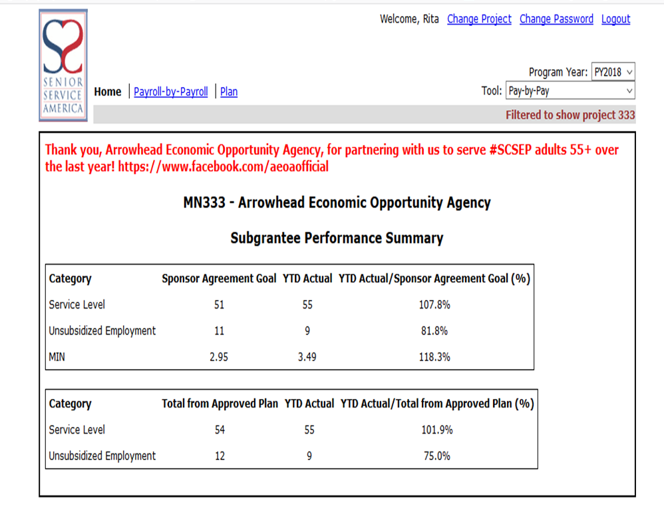
Recertification for PY2018
Identify staff that will help you
Train staff to assist – (participant staff cannot make final eligibility determination another participant)
Participant eligibility determination forms, must be signed by PD or sponsor staff, not participant staff.
Ensure all team members have access to Tools/SPARQ

Slide 12
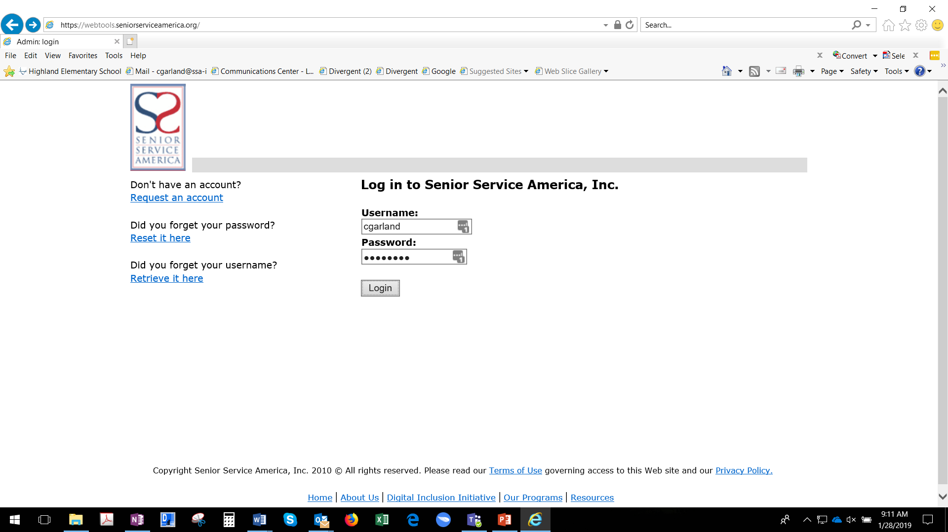
Requesting Access to SSAI Tools

Slide 13
Readiness Steps for PY2018
The SSAI Eligibility Determination Tool will be available for practice Feb. 1st through Feb. 28th on the SSAI Review site: https://webtools-review.seniorserviceamerica.org/
Eligibility Tool will be available on the live site beginning March 1st: www.seniorserviceamerica.org
Contact your Program Officer, call 301-578-8989, email scsephelp@ssa-i.org or open a case to authorize additional user IDs and passwords you request.

Slide 14
Readiness Steps for PY2018
Review the active participants in SPARQ
If participants remain on your active list, who have exited, complete information on Exit forms and enter in SPARQ.
If any participants are on your payroll but not “active” in SPARQ, complete information on Participant forms and enter in SPARQ

Slide 15
Readiness Steps for PY2018
Identify and train other staff that will complete recertification or assist
  Will you include SCSEP Participant Staff?
Reminder: Project Director must review recertification documents completed by participant staff
Participant Staff may not sign any recertification/eligibility determination forms.

Slide 16
Readiness Steps for PY2018
Identify the location(s) where recertification meetings will occur:
  Are locations accessible to all participants?
  Assure you will have access to a copy machine so that you can make copies of the required verification documentation.
    You must attach copies with the Recertification – Income Worksheet, the Recertification Tool Print Out Document.
    You must retain these as well as copies of income resources, and family size verification documentation in each participant’s file

Slide 17
Readiness Steps for PY2018
Identify appointment times and secure meeting locations for each participant
  Individual appointments for each participant
include enough time to calculate the new income, offer the annual Physical Examination
  Add time if you will need to update any other information for a participant
Allow time for make up appointments and data entry by March 29th.

Slide 18
Readiness Steps for PY2018
The SSAI Eligibility Determination Tool will be available for practice Feb. 1st through Feb. 28th on the SSAI Review site: https://webtools-review.seniorserviceamerica.org/
Practice Practice Practice
Eligibility Tool will be available on the live site beginning March 1st: www.seniorserviceamerica.org

Slide 19
Readiness Steps for PY2018
Print plenty of blank copies of these forms, if conducting recertification meetings off-site?
  Recertification - Income Worksheets (Required – unless you will calculate income on the tool and print hard copy for signatures)
  Offer of Physical Examination Form (Required)
  SCSEP Family Size Form
  SCSEP self-attest for zero income
  Case Notes/ Forms
  Release Forms for UE exits

Slide 20
Readiness Steps for PY2018
Plan to notify participants who may be over income during the recertification meeting:
  Participants must be given 30 day written notice. They may continue at their host agency for the 30 days.
Complete the Exit form
  be sure to capture this as an Excludable exit on Page 1 of the Exit Form, #6.1. ix
  and the enter in SPARQ 30 calendar days after the meeting date

Slide 21
Readiness Steps for PY2018
Plan to notify participants who fail to show for their recertification meeting or who failed to complete recertification by the deadline:
  Must be exited for Cause
  Must be given 30 day written notice
  Should be placed on approved break for 30 day period
  Complete the Exit form and enter in SPARQ 30 days after the notice of termination is sent

Slide 22
Readiness Steps for PY2018
Plan to enter all recertification data in the SSAI Eligibility Webtool
  Can be entered directly in the tool if you have access to a computer during appointments
  Or collected on the Recertification Income Worksheets and entered after appointment
Plan to enter all recertification data in SPARQ
  Enter Income calculated by the Eligibility determination webtool

Slide 23
Readiness Steps for PY2018
Have a system for quality assurance check for the following?
Are income calculations correct
Are all papers signed
Are resource documents copied for files
Work completed by Participant Staff is reviewed by Project Director
Entering data in SSAI Recertification Webtool
Entering data in SPARQ

Slide 24
Readiness Steps for PY2018
Checklist and Readiness Calendar will guide you through the recertification steps
It is recommended that new Program Directors, review your recertification plan with your Program Officer

Slide 25
Questions

Slide 26
Income Eligibility and Calculations

Slide 27
What is needed to calculate income?
Family Size
What Types of Income each Family member receives
Source documents for 12 or 6months of (Includable) income prior to the date of enrollment

Slide 28
Determining Family Size
PPM section 204A-C provides definitions of family size and how to determine a participants family size.
Definition of Family:
For the purpose of determining income level for eligibility in SCSEP, family is when members live in the same household and is defined as:
A husband, wife and dependent children who reside together; or
A parent or guardian and dependent children who reside together; or
A husband and wife who reside together.

Slide 29
Definition of Family
If the applicant is claimed as a dependent on the federal income tax return of another family member with whom they reside, then the family is defined as:
a group of two or more people related by birth, marriage or adoption and
residing together;
all such people (including related sub-family members) are considered as members of one family.

Slide 30
Sub - Family
Related sub-family.
A related sub-family is a married couple with or without children, or one parent with one or more of their never-married children less than 18 years old, living in a household and related to, but not including, the person or couple who maintains the household.
One example of a related sub-family is a young married couple sharing the home of the husband’s or wife’s parents.

Slide 31
Sub - Family
Unrelated sub-family.
Unrelated sub family are not included in family size.
  Unrelated adults residing together
  Roommates etc.

Slide 32
Definition of Family
A person with a disability may be treated as a “family of one” for income eligibility determination purposes.
  the applicant must provide the required source documentation to validate their disability status.
Same-sex spouses are included within the definition of “family” for income calculation/eligibility purposes.

Slide 33
Documentation of Family Size
SCSEP Family Size Form.
Documentation of disability.
Current 1040 listing dependents.
Lease or other official documentation.
  Only acceptable if it lists all residents.
  Leases or other documents that do not list all residents are not acceptable.
  Must retain copies of the entire document in the participant file.

Slide 34
Family Size Exercise
Participant is disabled and living with her adult child, and her child claims her as a dependent on income taxes.
What is the Family Size?
What document would you use to validate?

Slide 35
Family Size Exercise
The participant shares the household with his girlfriend and her 3 children.
What is the Family Size?
What document would you use to validate?

Slide 36
Family Size Exercise
Participant is married with 2 grandchildren, ages 16 and 17, living in the household and claimed as his dependents on his income taxes. Both grandchildren work as well as receive child support.
What is the Family Size?
What document would you use to validate?

Slide 37
Family Size Exercise
Participant is a widow and lives with her totally disabled daughter (age 31), son (age 28), her son's wife and his wife's two children.
What is the Family Size?
What document would you use to validate?

Slide 38
What income is excluded?
P&P Manual Section 204G identifies income that should NOT be included when calculating income.

Slide 39
Excluded Income:
See PPM Section 204G
Social Security Disability/ Supplemental Security Income
Unemployment Compensation
Dept. of Veterans Affairs Payments
Public Assistance or Welfare Payments
Disability Benefits
Income from any Title V wages

Slide 40
Excluded Income:
See PPM Section 204G
Child Support or Foster Care payments
Workers Compensation
Payment to Native Americans pursuant to the Indian Claims Act
Payments to certain volunteers
Sale of Property
Reverse mortgage payments
Other income
  Lump sum Inheritance/lottery winnings etc.
  Insurance Payments

Slide 41
What income is included?
P&P Manual Section 204F identifies income that SHOULD BE included when calculating income.

Slide 42
Included Income:
See PPM Section 204F
Gross Wages and Salary
Net Earning From Self-Employment
Social Security reduced by 25%
Survivors’ Benefits excluding VA benefits
Pension or retirement income
Interest income
Dividends

Slide 43
Included Income:
See PPM Section 204F
Rent, Royalties, Estates and Trusts
Educational Assistance
Alimony
Financial Assistance from outside the household
Other income: Count all payments and applicants receive regularly.

Slide 44
How do we
Calculate the Income?

Slide 45
Method of Computing Income
Annual family income and the income for a single individual must be computed by one of two methods.
The method which is more beneficial to the applicant is to be used.

Slide 46
Income Computation Method
Method One: Compute the actual countable income for the 12 months preceding the date of application.
Method Two: Compute the actual countable income for six months preceding the date of application and then multiply by two (or annualize).

Slide 47
Income Computation Method
Example:
An individual in a family of two people applies on July 1 with countable income of $25,000 for the preceding 12 months
But only $4,000 of that $25,000 was countable in the six-month period before he or she applied
Which Income Computation Method would you choose?

Slide 48
Income Computation Method
Example:
12 month Method:
  the individual would have a family income of $25,000 using Method One
6 month Method:
  the individual would have a family income of $8,000 using Method Two
  $4,000 counted for the six months preceding the date of application multiplied by 2

Slide 49
Income Computation Method
Q: How do we determine which look back period to use; 12 months, or 6 Months Annualized?
A:
There is no preference for either method but the you must use the method which most benefits the participant.
If a participant is over income, you should always do the calculation again using the other method.

Slide 50

Q1: SSDI &
Full Retirement Age
Q: For participants who receive SSDI, should this cash benefit be counted when they turn 65?
A: No.
  SSDI benefits convert to Retirement Benefits the month the participant reaches Full Retirement Age.
  Full Retirement Age is no longer 65.

Slide 51
SSDI & Full Retirement Age
 | Full Retirement Age
1937 | 65
1938 | 65 and 2 months
1939 | 65 and 4 months
1940 | 65 and 6 months
1941 | 65 and 8 months
1942 | 65 and 10 months
1943 - 1954 | 66
1955 | 66 and 2 months
1956 | 66 and 4 months
1957 | 66 and 6 months
1958 | 66 and 8 months
1959 | 66 and 10 months
1960 and Later | 67
* If you were born on January 1st of any year you should refer to the previous year. (If you were born on the 1st of the month, we figure your benefit, and your full retirement age as if your birthday was in the previous month.

Slide 52

Q2: Look Back Period
Q: If we recertify someone March 15 and they will receive their Social Security check on March 27, How do we enter it on your website worksheet? Do we put $0 for March? Would this person only have 5 months of Social Security if using the 6 month annualized method?
A: No:
  Remember that you must look back 6 or 12 months from the date you are completing the enrollment or recertification.
  The look back months are not the same as Calendar Months, and will nearly always overlap into 2 Calendar Months

Slide 53
Look Back Period
When completing an eligibility determination conducted on March 15th, 2019, the income worksheet should be completed as follows:
Month | Dates | Income to be included:
1 | March 15^{th,} 2019-February 16th, 2019 | All income received between 03/15/19 and 02/16/19
2 | Feb. 15th, 2019 – Jan. 16th, 2019 | All income received between 02/15/19 and 01/16/19
3 | Jan. 15th, 2019– Dec. 16th, 2018 | All income received between 01/15/19 and 12/16/18
4 | Dec. 15th, 2018 – Nov. 16th, 2018 | All income received between 12/15/18 and 11/16/18
5 | Nov. 15th, 2018 – Oct. 16th, 2018 | All income received between 11/15/18 and 10/16/18
6 | Oct. 16th, 2018 – Sept. 16th, 2018 | All income received between 10/15/18 and 09/16/18

Slide 54
Look Back Period
Example:
A Participant is being recertified on March 15th, 2019. The participant is a family of one, and has two sources of includable income. The participant receives a Social Security Retirement benefit, which they receive on the 27th of each month, and a pension which they receive on the 1st of each month.
The 6 month look back period for this participant would include:
Month | Dates | Income to be included:
1 | Mar 15^{th,} 2019 – Feb 16th, 2019 | Pension: 03/01/19, SS 02/27/19
2 | Feb. 15th, 2019 – Jan. 16th, 2019 | Pension: 02/01/19, SS 01/27/19
3 | Jan. 15th, 2019 – Dec. 16th, 2018 | Pension: 01/01/19, SS 12/27/18
4 | Dec. 15th, 2018 – Nov. 16th, 2018 | Pension: 12/01/18, SS 11/27/18
5 | Nov. 15th, 2018 – Oct. 16th, 2018 | Pension: 11/01/18, SS 10/27/18
6 | Oct. 15th, 2018 – Sept. 16th, 2018 | Pension: 10/01/18, SS 09/27/18

Slide 55
Look Back Period
6 versus 12 months
You can use either, which ever is most beneficial to the participant. When using 6 months, please multiply by two.

Slide 56
Q3: Social Security COLA
Q: Was there a Social Security Cost of Living Adjustment (COLA) for 2018?
A: Yes, there was a COLA for 2019 (2.8% increase).
  Project Directors are required to verify the monthly cash benefit amounts for 2018 and 2019 for Social Security Retirement beneficiaries.
  More information about Social Security COLA’s can be found at http://www.ssa.gov/cola/

Slide 57
Income Calculation FAQ
Q: Some participants receive their Social Security Benefits on the 3rd of the month, Others receive theirs on different dates, such as the 2nd Wednesday of the month. How do we determine how to count the benefits?
A:
Beneficiaries who began receiving benefits prior to May 1997, or who also receive SSI benefits are paid on or about the 3rd.
Other beneficiaries are paid on different dates based on their date of birth.

Slide 58
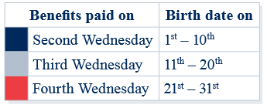
Recertification Q & A
The Social Security Administration provides calendars which show the payment dates for each year:
https://www.ssa.gov/pubs/EN-05-10031-2019.pdf
https://www.ssa.gov/pubs/EN-05-10031-2018.pdf

Slide 59
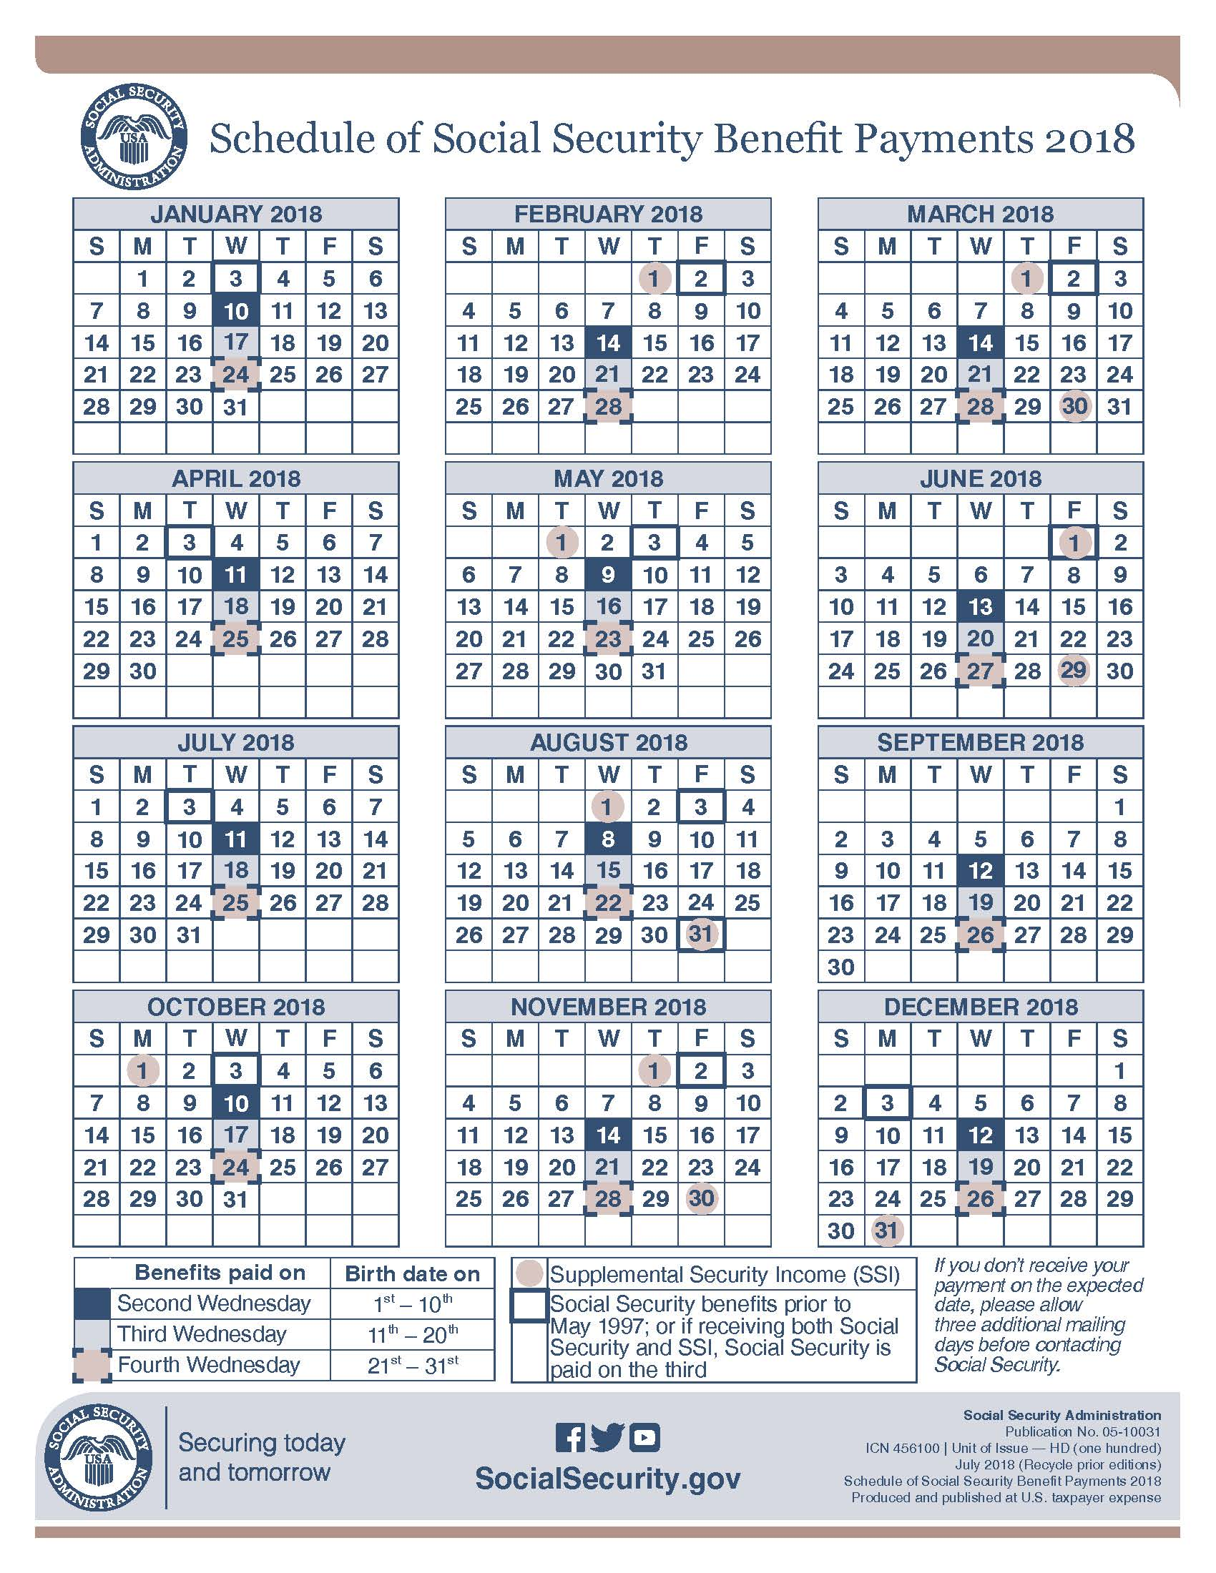

Slide 60

Q4: Payments to Veterans
Q: How do I determine if the benefits received by a Veteran are countable income?
A:
All payments made by the Department of Veterans Affairs (VA) are excluded
All Payments Made by the Department of Defense/Defense Finance and Accounting service are included

Slide 61

OTHER QUESTIONS
Confer by Phone or Send Us a Note

Slide 62
SPARQ & SSAI Tools Considerations
Reconcile the active participants in SPARQ and SSAI Tools with your payroll registers:
All Active Participants must be in both SPARQ and SSAI Tools in order to complete recertification.
Complete Participant and Exit forms and enter in SPARQ
Contact your Program Officer or SSAI Connect if you need assistance.

Slide 63
SSAI
Recertification
Webtool

Slide 64
Recertification for PY2018
SSAI Eligibility Determination Tool:
Serves as both Calculator and Recert Documentation
  Improves accuracy of calculations
  Improves Data Validation results
SSAI Eligibility Determination Tool will continue to be required for recertification

Slide 65
SSAI Recertification for PY2018
Projects have the option of:
(a) Entering the recertification information directly into the Eligibility Determination Tool
  Must have an Internet Connection and access to a printer.
  Print out and secure the Participant and Project Staff Signatures on the SCSEP Income Eligibility Form generated by the Eligibility tool for each participant

Slide 66
SSAI Recertification for PY2018
b) Income Calculations can also be completed by hand using the Income Worksheet
  Secure Participant and project staff signatures directly on the completed income worksheet
  You must also enter the data from the worksheet into SSAI’s Eligibility Determination tool.
  When printing the summary from the eligibility tool, opt-out of printing signature lines by selecting that signatures were already obtained.
  Staple the Income Worksheet(s) and printed eligibility tool documents together and retain in each participant’s file.
  When entering in SPARQ, always enter the amount from the Eligibility Tool, not from calculation done by hand.

Slide 67
Requesting Access to SSAI Tools

Slide 68
Log-In to SSAI Tools

Slide 69
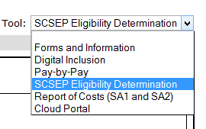
SSAI Recertification Webtool
Select SCSEP Eligibility Determination from the Tool drop down

Slide 70
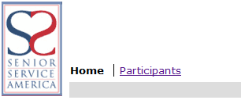
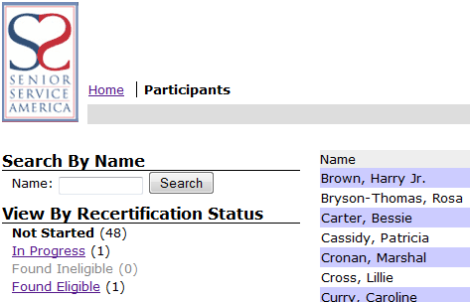
Recertification
Recert Participant List
To access the recertification list click on Participants.
The list shows 15 participants at a time and you can move around the list by clicking Previous or Next
You can search by typing a participant name
The list can be filtered by:
  Not Started - A listing of all participants that needs a recertification entered
  In Progress – A listing of all participants that has a recertification that has been started
  Found Ineligible - A listing of all participants found ineligible during recertification
  Found Eligible - A listing of all participants found eligible during recertification

Slide 71
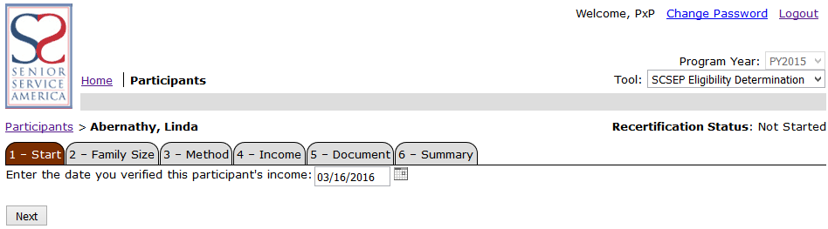
Recertification
Enter Recertification
To Enter a Recertification – Click on the Eligibility Status link
The process has 6 steps:
  Start
  Family Size
  Method
  Income
  Document
  Summary

Slide 72
Recertification
Enter Recertification – Step 1
Start
  Enter the date you verified the participant’s income. Date entry must be in the format of mm/dd/yyyy.
  Click next to save your entry and move to the next step

Slide 73
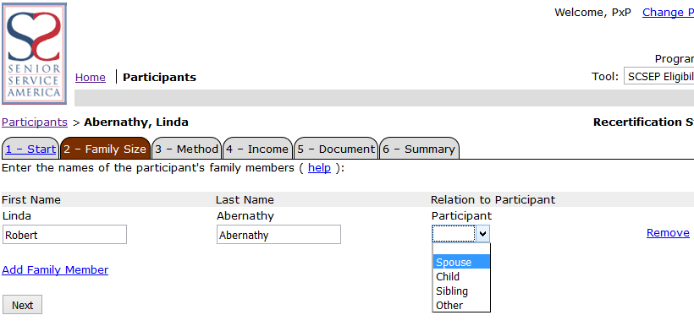
Recertification
Enter Recertification – Step 2
Family Size
  By default, the participant is shown
  To add additional family members click add Family Member, enter their name, and select their relationship to the participant
  You can click the remove link if you want to remove an incorrect row
  Click next to save your entry and move to the next step

Slide 74
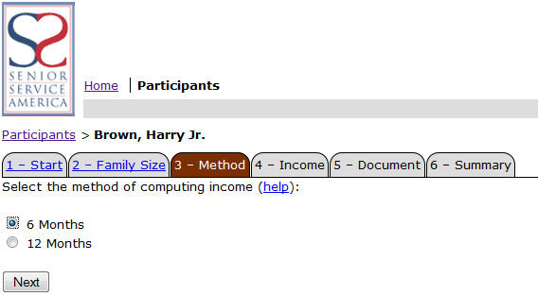
Recertification
Enter Recertification – Step 3
Method
  Select either 6 months annualized or 12 months. For help on which method to select click the help link.
  Click next to save your entry and move to the next step

Slide 75
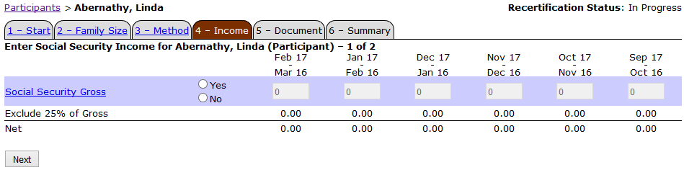
Recertification
Enter Recertification – Step 4
Income
  To enter Income for the participant and for any other Family member select either yes or no for each income type
    For Social Security, you must enter The Full monthly Social Security benefit before any deductions, rounded down to the nearest dollar. The tool will automatically calculate and exclude 25% of Social Security
    If you select No to any of the 12 income types, you do not have to enter any amount
    If you select Yes to any of the 12 income types, you must enter all amounts and enter zero if none. For example, if participant received income only for 3 months, you would enter the amounts for those 3 months and enter 0 for the other months
  Click next to save your entry and move to the next step

Slide 76
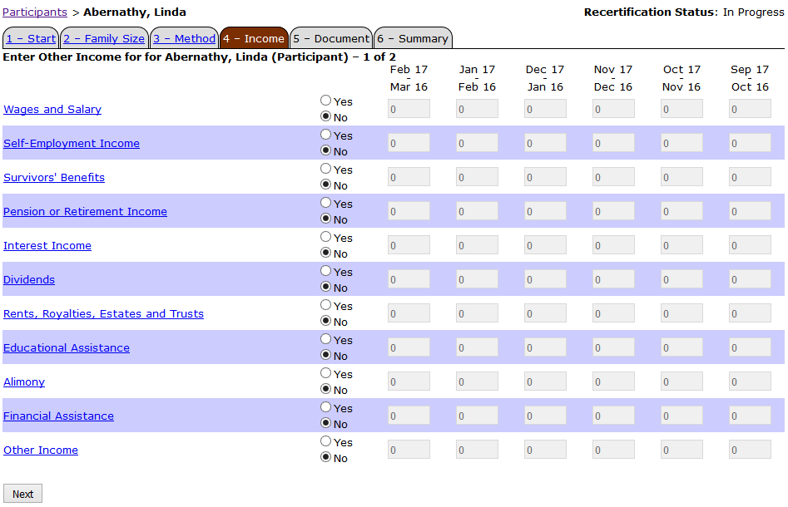
Recertification
Enter Recertification

Slide 77
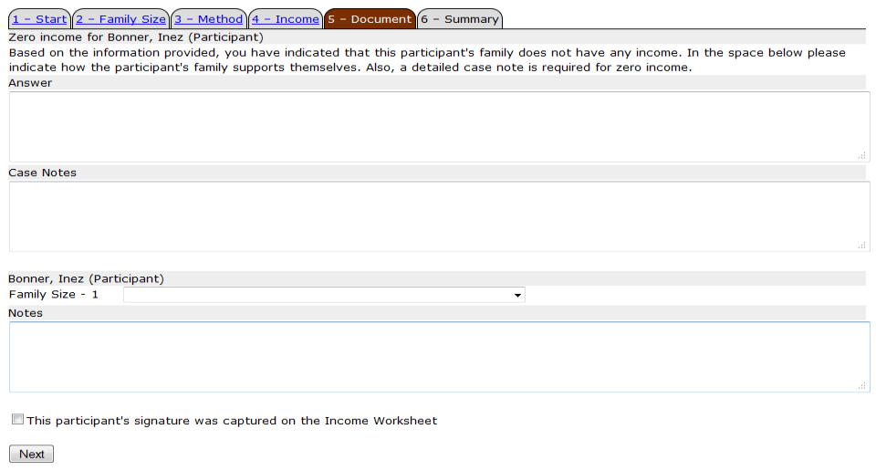
Recertification
Enter Recertification – Step 5
If the total income for the participant and for any other family member is zero
  Document how the participant supports themselves
  And capture a detailed case note
  Click next to save your entry and move to the next step

Slide 78

Recertification
Enter Recertification – Step 5
When completing recertification in the field (without a computer or later), and entering data at a later time, the participant’s signature must be captured on the Income Worksheet.
  Check the box in step 5 to indicate that the participant signature was captured
  Do not check this box if entering directly into the eligibility tool, and signature is needed on the print-out

Slide 79
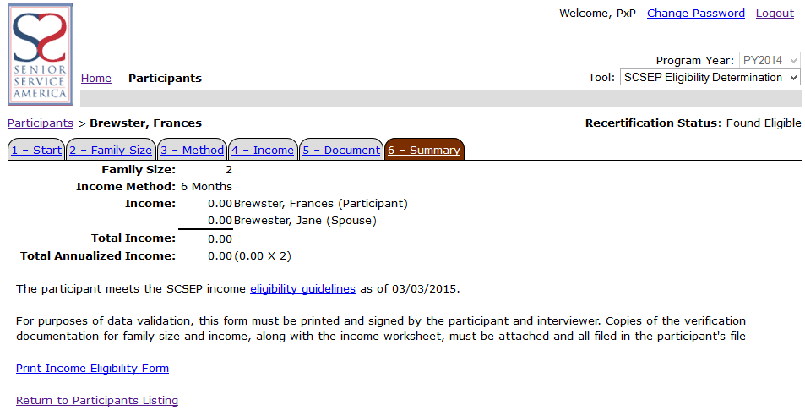
Recertification
Enter Recertification – Step 6
Summary
  At this point, all the data entered is summarized and the income eligibility is automatically determined
  For purposes of data validation, this form must be:
    Printed and signed by the participant and interviewer; or
    Printed and attached to the income worksheet completed and signed in the field.
  Copies of the verification documentation for family size and income, along with the income worksheet, must be attached and all filed in the participant's file
  Click print to print the summary and income worksheets
  Click return to get back to your recert list

Slide 80
ENTERING DATA INTO
SPARQ

Slide 81
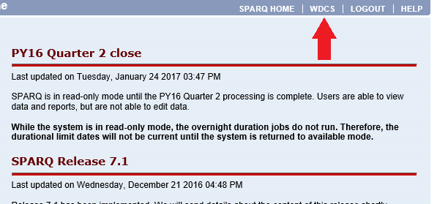
Recertification
SPARQ Entry
Select WDCS from the SPARQ Homepage

Slide 82
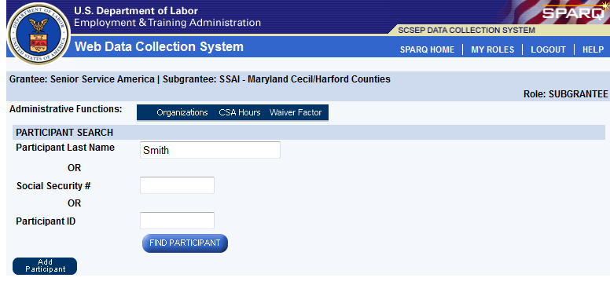
Recertification
SPARQ Entry
Search for Participant by last name, Social Security Number, or PID

Slide 83
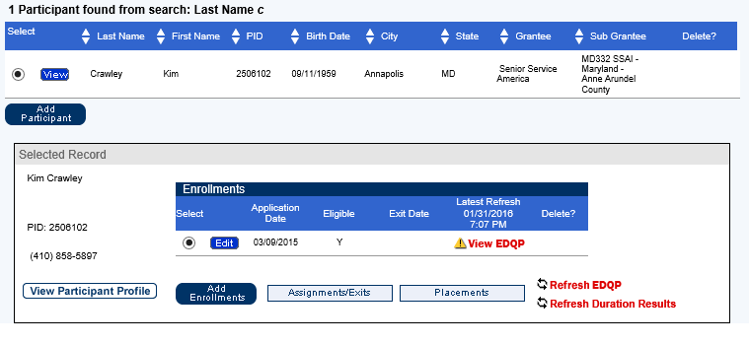
Recertification
SPARQ Entry
Select the Participant; once the record appears below, select Edit

Slide 84
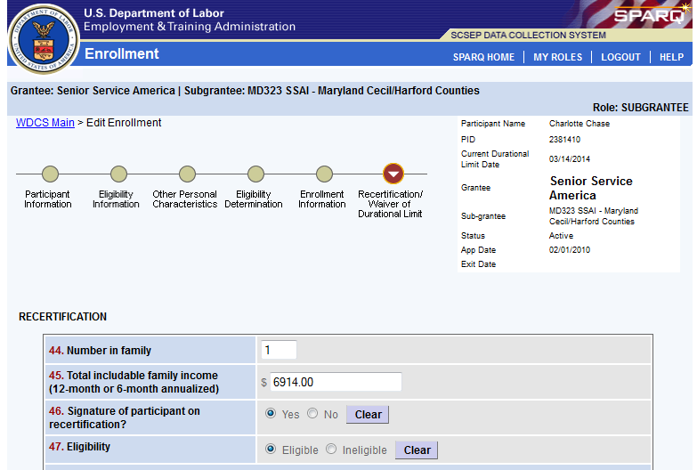
Recertification
SPARQ Entry
Select Recertification/Waiver of Durational Limit Tab

Slide 85
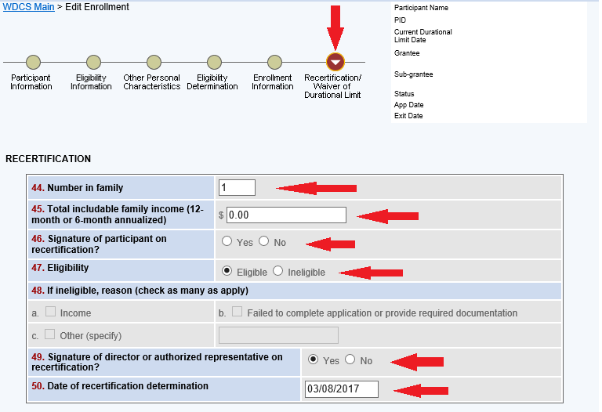
Recertification
SPARQ Entry
Complete Recertification Section: fields 44 – 50

Slide 86
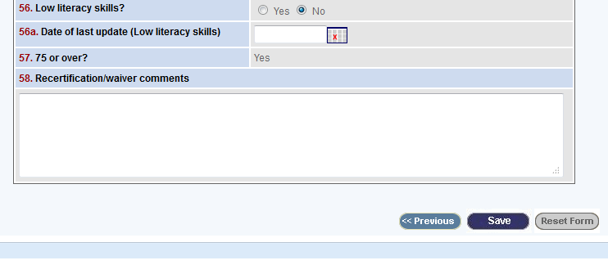
MIN / Waiver
SPARQ Entry
Save once you are finished entering the data

Slide 87
ANY FINAL QUESTIONS
Confer by Phone or Send Us a Note

Slide 88
Recertification Best Practices
Take advantage of the time you have with each participant
Check in with participants to assess needs for supportive services, etc.
Complete Release Form, Record of Offer of Physical Exam, and any Reassessment/IEP updates

Slide 89
Questions After This Webinar
Contact Your Program Officer or
SSAI Connect by:
  Emailing: scsephelp@ssa-i.org; or
  Calling: 301-578-8989; or
  Opening a case via SSAI Connect

Slide 90
THANK YOU!

