Slide 1
Notes from the Road Webinar June 29th with Elizabeth White
Author
Fifty-five, Unemployed, and Faking Normal

Slide 2


Elizabeth White Author

Slide 3
How I Landed Here…
Published essay in Next Avenue 18 months ago
Shared my experience and that of my friends
Over 11,000 “Likes” and 1,000 comments
Dozens of emails
Notes:
Did not see myself in popular media accounts of near retirees.
No one I knew was traveling the world or buying a condo in Costa Rico.
Many I knew were facing a work for life proposition one surprise event away from financial ruin.
Almost no one had set aside the 15 to 20 times their annual salaries financial planners say we need to maintain our current standard of living.
With life expectancy now north of eighty, that’s a lot of years to make ends meet.
Shame and embarrassment keeps many people silent about their situation. It’s easy to think you’re alone.

Slide 4
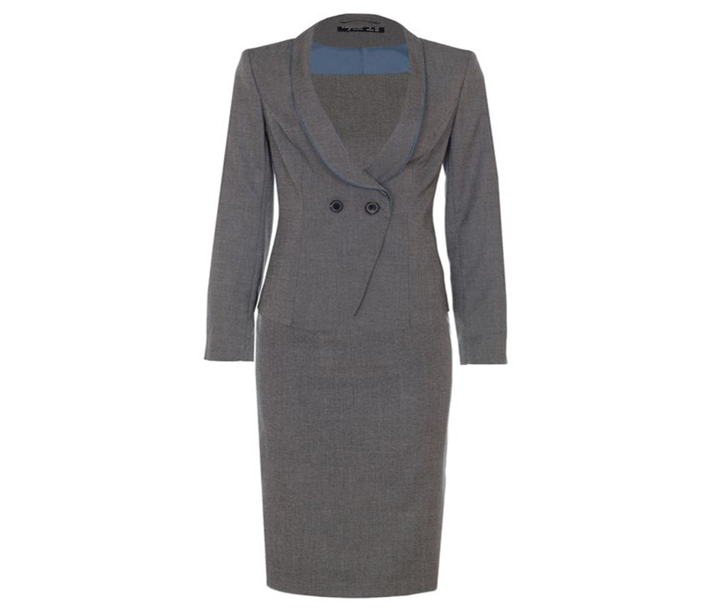
“You Know Her”
Notes:
Your speech

Slide 5
But how is this Relevant?
$12 glass of Chardonnay
Dining out
Clothes “still impeccable”

Slide 6
Traditional SCSEP Participant
Age 55 or older
Family income below 125% of poverty
Faced barriers and cumulative disadvantage
High school graduate/little college

Slide 7
Changes in SCSEP Participant Composition Post 2008/9
Still age 55 or older with family income currently below 125% of poverty
But 43% now have some college
More white collar and pink collar participants
History of career options and middle - high income
Landed here because of some unforeseen event – job loss, divorce, medical diagnosis

Slide 8
Site Visits
Diann James, Program Coordinator/Project Director SCSEP, Prince George’s County (Maryland) Government, Department of Family Services
CaSondra Amos, Associate Vice President, Senior Employment, Meritan, Memphis, TN
Jeana Mills, Senior AIDES/SCSEP Project Director, The Northwest Tennessee Human Resource Agency, Martin, TN
Stephanie Johnigan, Program Director, Senior Aide Program, Catholic Charities of the Archdiocese of Chicago

Slide 9
Site Visits
Site selection based on proximity to HQ, other business in site location, opportunity to assess how book’s message played with traditional and non-traditional SCSEP participants
Discussed visit with Project Directors
Interviewed 3-5 SCSEP participants selected by program manager before my visit

Slide 10
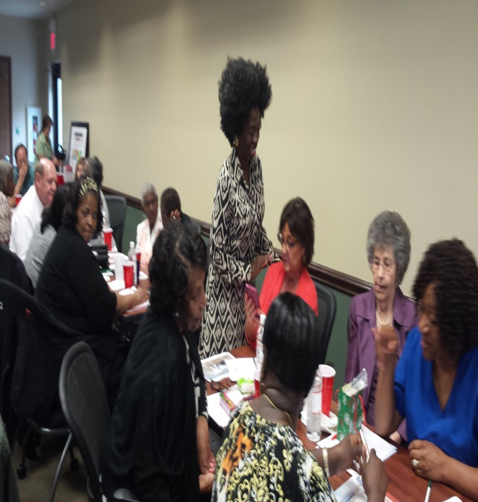
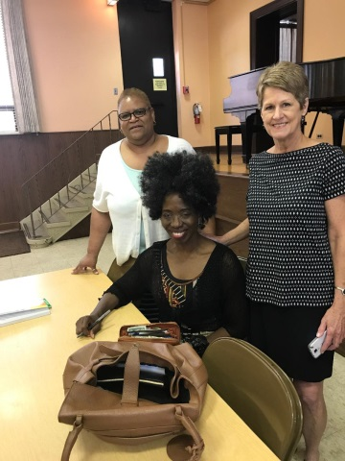
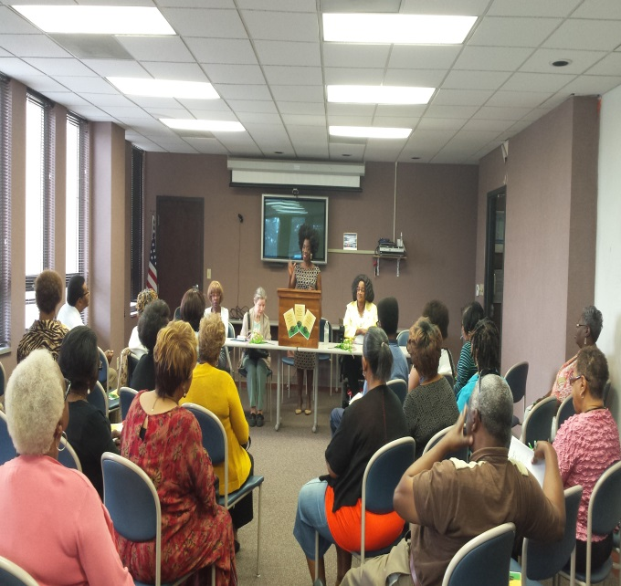
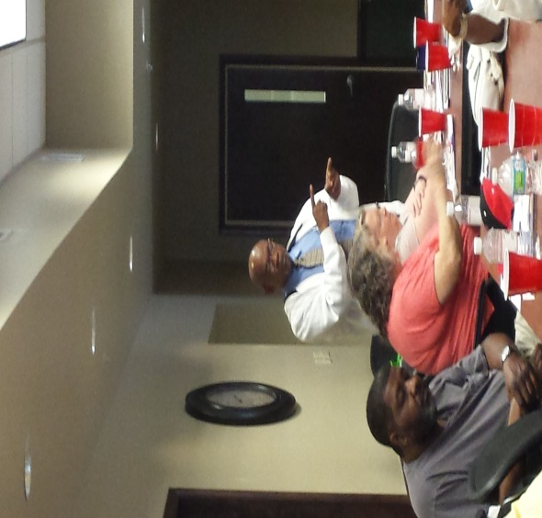
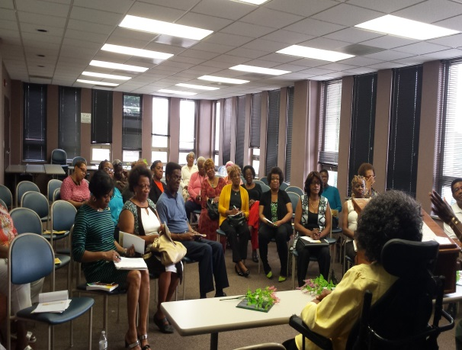
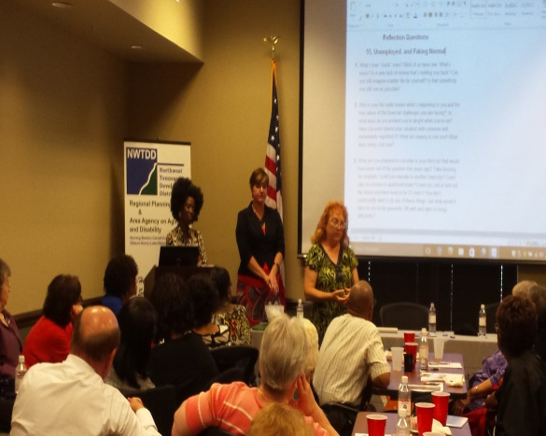
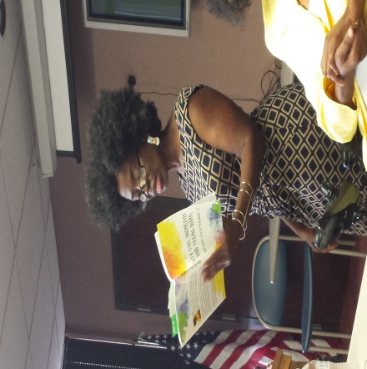
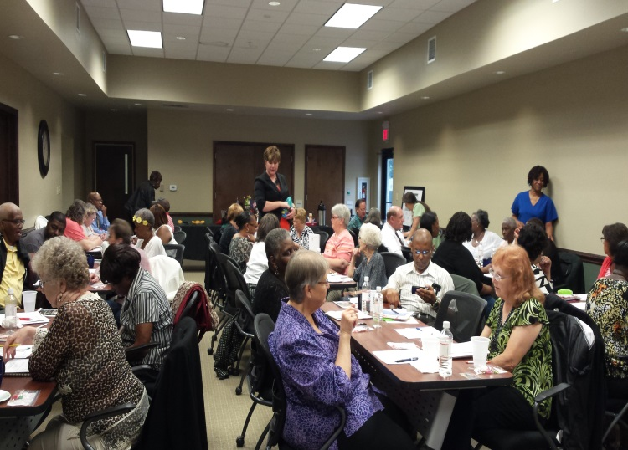

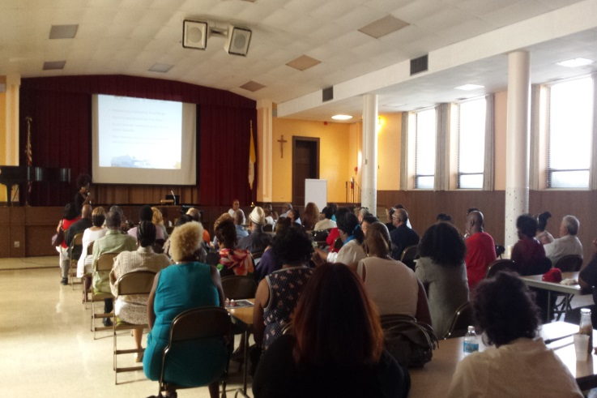

Slide 11
Shock of Facing Downward Mobility
Few have set aside the 15 to 20 times their annual salaries financial planners say we need to maintain our current standard of living
With life expectancy now north of eighty, that’s a lot of years to make ends meet
Shame and embarrassment leaves many people feeling alone and isolated

Slide 12
How Bad is It?
Half of American households have no retirement savings
Not a dime
29 percent of households age 55 and older have neither retirement savings nor pensions
Among those 55-64 with some retirement savings the median account value is $104,000

Slide 13
How Bad is It?
50% = $0.00
Avg. = $104K

Slide 14
How bad is it?
47 percent of Americans cannot pull together $400 for an emergency
Half of Americans have less than $1,000 in their checking and savings accounts
One in four Americans tap their 401(k) to make ends meet

Slide 15
My Story
Army “brat”
Undergraduate degree from Oberlin College
Masters in International Studies from Johns Hopkins
Harvard MBA
World Bank dream job at 30
Bought Condo same year

Slide 16
My Story
Entrepreneur
Retail stores in 3 states and the District of Columbia
NRF Small Retailer of the Year
Used savings to support business
Closed business in 2002

Slide 17
My Story
Back in the job market in 2002
Hired right away
Worked two long-term contracts
Great Recession of 2008 hit
Lost both contracts within six months
High earner to $0 overnight

Slide 18
Faking Normal
Not worried initially
Trying to keep up appearances
Noticing cracks in the façade of friends
Started talking to my circle
Disconnect between media portrayals and our own experience

Slide 19
The Good Life?
Notes:
Tired of faking normal.
I wasn’t seeing my story in the popular press.
And I definitely did not identify with those cheery little reinvention stories I read about in the paper …You know the ones. Lawyer turned pastry chef. Accountant turns opera singer. Couple w/ successful BNB
I don’t know these people…
Very few have set aside the 15 to 20 percent of their salary to maintain our current standard of living in retirement.
In our fifties and sixties, we are, a work for life proposition, one job loss, medical diagnosis or divorce away from insolvency.

Slide 20
Still Hiding
Notes:
Even as I was coming out, I was still hiding
We live in a winner’s society still hiding
You think something is wrong with you
So I say let’s own our part.

Slide 21
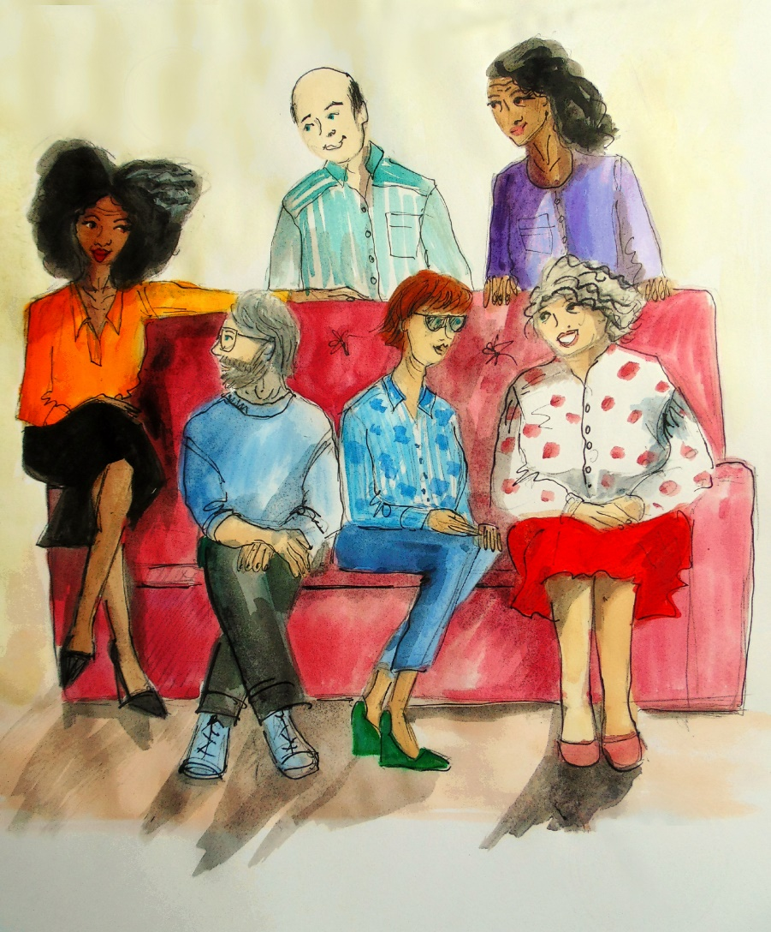
Still Hiding

Slide 22

Blaming and Shaming
Must be all our fault
Dead beats and slackers
All that frivolous spending on “unnecessaries,” like nail appointments, bottled water and coffee drinks
Notes:
Blaming and shaming is so deliciously tempting… Where we landed must be all our fault. A country of dead beats and slackers All that frivolous spending on “unnecessaries,” like bottled water and coffee drinks.

Slide 23
Let’s Own Our Part!
We all could have saved more
We’ve all done some dumb stuff financially, blundered, have regrets
But the retirement income gap is not primarily a personal responsibility issue
We’re not here because of our trips to Starbucks
Notes:
We all could have saved more.
We’ve all done some dumb stuff financially, blundered, have regrets.
But the retirement income gap is not primarily a personal responsibility issue
We’re not here because of our trips to Starbucks

Slide 24
So what happened?
30 years of flat and falling wages
47 percent increase in the median home price 575 percent increase in health care costs
260 percent increase in the cost of college

Slide 25
Big Take Away #1
Not alone
There are millions of us
Notes:
Even manufacturing jobs brought back through reshoring will not be the same jobs as in the past.

Slide 26
Big Take Away #2
The Cavalry is Not coming
Notes:
Even manufacturing jobs brought back through reshoring will not be the same jobs as in the past.

Slide 27
Big Take Away #3
First is always hardest (longevity bonus)
No role models
No established pathways
No supportive policies
Notes:
Even manufacturing jobs brought back through reshoring will not be the same jobs as in the past.

Slide 28
Big Take Away #4
Get Rid of Magical Thinking

Slide 29
New Reality Check
Dawns on us that we won’t be making the money we’re used to making
Many of us are facing months and years of unemployment that deplete our savings and shake our confidence
Looking at a future of contract work and part-time jobs

Slide 30
Big Take Away #5
Get off the throne
Notes:
Even manufacturing jobs brought back through reshoring will not be the same jobs as in the past.

Slide 31

Big Take Away #6
Bridge Work to pay the bills and figure out what’s next

Slide 32
Big Take Away # 7
Think multiple income streams
Gig economy – contract, contingent, part-time/temporary jobs

Slide 33
Big Take Away #8
Smalling UP
How do we cut back and still have good quality of life, still be connected to what we love and what has meaning for us

Slide 34
Smalling UP
“Smalling Up”

Slide 35
Big Take Away #9
Think Strategy Not Failure

Slide 36
Think Strategy Not Failure
Do what you need to do to go another round
If you need to get food stamps get them
If you need to move in your brother for awhile--Call him
If you need to get rid of that gas guzzling SUV, get rid of it
If you need to move into a smaller apartment, or get a roommate--Do it

Slide 37
Big Take Away #10
Resilience Circles

Slide 38
Ten Big Take Aways
You’re not alone
The Cavalry is not coming
First generation to be here
Get rid of magical thinking
Get off your throne
Bridge work
Think multiple income streams
Small Up
Think strategy not failure
Resilience Circles

Slide 39

Elizabeth White
Lizzy@55andfakingnormal.com
https://www.createspace.com/6072635
20% Discount Code for 25 or more books: CG9ULJMV

